Slide 1

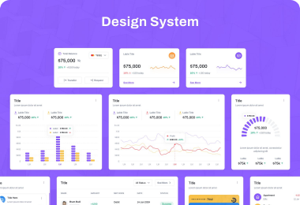
DATA ANALYTICS & FINANCIAL ENGINEERING
Power BI | DAX | IFRS 9
AUTO LOAN SECURITISATION ANALYTICS
Comprehensive Module Framework for Portfolio Performance, ECL Staging & Cash Flow Waterfall Modeling
8-Module Enterprise Solution
Investor & Risk Reporting

Slide 2
Architecture Overview
CORE SYSTEM MODULES
MODULE 1: DATA MODEL
MODULE 2: PORTFOLIO KPI
MODULE 3: DELINQUENCY
Star schema architecture.
Balance & characteristic metrics.
Early-warning monitoring.
• Fact performance tables
• Dimension relationships
• High-speed DAX engine
• Active vs defaulted balances
• WAC, WAM, WALA calculations
• Weighted LTV & CIBIL
• 30 / 60 / 90+ DPD buckets
• Roll-rate migration matrices
• Early trigger warnings
MODULE 4: IFRS 9 ECL
MODULE 5: CASH WATERFALL
MODULE 6: INVESTOR TAPES
Staging & impairment engine.
Tranche cash allocation.
Automated rating agency reports.
• Stage 1, 2, 3 classification
• PD × LGD × EAD formulas
• Provisioning variance
• Senior / Mezz priority
• OC & IC coverage ratios
• Reserve account drawdowns
• Standard ESMA data tapes
• Excel-backed audit checks
• Automated PDF summaries

Slide 3
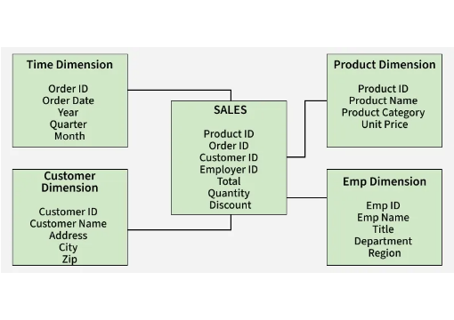

Module Breakdown
MODULE 1: DATA ARCHITECTURE & STAR SCHEMA
DIMENSION TABLES
DimLoan: Account IDs, origination date, tenure, interest rates.
DimBorrower: CIBIL credit score, income band, DTI, employment type.
DimVehicle: New/used tag, LTV ratio, manufacturer class.
FACT TABLES
FactMonthlyPerformance: Monthly collections, principal & interest split.
FactDPDSnapshot: Monthly days-past-due status and roll-rate flags.

Slide 4
Module Breakdown
MODULE 2: PORTFOLIO ANALYTICS & UNDERWRITING KPIS
A. Balance Metrics
B. Time Metrics
C. Credit Quality
PORTFOLIO OUTSTANDING
WAC / WAM / WALA
RISK CHARACTERISTICS
• Weighted Average Coupon (WAC)
• Weighted Average Maturity (WAM)
• Weighted Average Loan Age (WALA)
• Weighted LTV ratio: 78.4%
• Weighted CIBIL score: 742
• Weighted DTI ratio: 34.1%
• Total active pool balance tracking
• Current vs defaulted balance split
• Principal run-off rates
DAX Logic: Dynamic weighted-average measures recalculate instantaneously upon slicer filtering across originations, geographies, and car segments.

Slide 5
Module Breakdown
MODULE 3: DELINQUENCY BUCKETS & ROLL-RATE MATRIX
1. DPD BUCKET TRACKING
2. ROLL-RATE MATRIX
3. EARLY TRIGGER ALERTS
Categorization into strict delinquency bands:
Month-on-Month transition probabilities:
Automated portfolio health monitors:
• Current (0 DPD)
• 1 - 30 DPD (Early Alert)
• 31 - 60 DPD (Moderate Risk)
• 61 - 90 DPD & 90+ DPD (Default)
• Roll-forward rates (e.g. 30 → 60 DPD)
• Cure rates (e.g. 30 → Current)
• Write-off / Default entry tracking
• 30+ DPD threshold alerts (> 2.5%)
• Cumulative loss limit breach flags
• Originator servicer warning signals
ANALYTICAL OBJECTIVE
Predict eventual default migration early in the loan lifecycle to initiate targeted collection strategies before Stage 3 impairment.

Slide 6

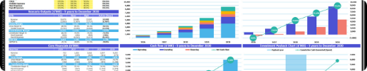
Module Breakdown
MODULE 4: IFRS 9 EXPECTED CREDIT LOSS (ECL) ENGINE
PART A
PART B
STAGING CRITERIA & LOGIC
ECL MODEL COMPONENTS
Stage 1 (Performing): 0-30 DPD. 12-month ECL provision applied.
Probability of Default (PD): Historical transition matrices & forward-looking macro overlays.
Stage 2 (SICR): 31-90 DPD or Significant Increase in Credit Risk. Lifetime ECL applied.
Loss Given Default (LGD): Vehicle collateral recovery haircut models.
Stage 3 (Credit Impaired): 90+ DPD / Default. Lifetime ECL provision required.
Exposure at Default (EAD): Amortization balance plus future drawdowns.
ECL CORE FORMULA
ECL = PD (%) × LGD (%) × EAD (₹)

Slide 7
Module Breakdown
MODULE 5: CASH FLOW WATERFALL & TRANCHE ALLOCATION
PRIORITY OF PAYMENTS EXECUTION ORDER
1. Collections
2. Senior Fees
3. Class A Note
4. Class B Note
5. Reserve Top-up
6. Equity Residual
OVERCOLLATERALISATION (OC)
INTEREST COVERAGE (IC)
RESERVE ACCOUNT MECHANICS
Maintains minimum asset-to-debt ratios for rating protection.
Checks available interest cash flows against note coupons.
Draws cash during shortfalls & replenishes in excess spread.

Slide 8
Module Breakdown
MODULE 6: STRESS TESTING & MACRO SCENARIO ENGINE
ECL STRESS PROVISION IMPACT (₹ MILLIONS)
STRESS PARAMETERS & SHOCKS
Base Case (Standard Macro)
₹11.67M
PD Multipliers: 1.25x - 2.50x default rate increase
Moderate Downturn (+25% PD)
₹16.03M
LGD Haircuts: 10% - 30% reduction in vehicle recovery value
Severe Recession (+75% PD, 20% LGD haircut)
₹20.99M
CPR / SMM Prepayment Speeds: High/low prepayment shifts
Extreme Stress (Stagflation Crisis)
₹23.33M

Slide 9
Module Breakdown
MODULES 7 & 8: INVESTOR REPORTING & AUDIT GOVERNANCE
MODULE 7: INVESTOR REPORTING
MODULE 8: RATING AGENCY TAPE
AUDIT & RECONCILIATION
• 100% Excel model cross-validation
• Automated Monthly Pool Summary PDF
• ESMA / CRISIL loan-level data tape
• Completeness & null value integrity checks
• Delinquency & Roll-Rate distribution
• Pool static performance statistics
• DAX vs SQL data verification
• Cash Waterfall payout reports
• WAC / WAM / WALA automated extract
• Row-Level Security (RLS) enforcement
• Trigger breach log notifications
• EAD & recovery data fields

Slide 10
Final Summary
PROJECT DELIVERABLES & VALUE REALIZED
8
80+
IFRS 9
100%
Integrated Analytics Modules
DAX & Financial Measures
ECL Engine & Stress Testing
Automated Data Tape
An end-to-end, production-ready framework providing institutional investors, credit risk managers, and rating agencies with complete transparency into auto loan securitisation portfolios.
AUTO LOAN SECURITISATION ANALYTICS FRAMEWORK
End of Presentation

